Slide 1
Plant Disease Detection using Convolutional Neural Network
Submitted By:
Akhilesh Singh- 2100290100015 Awadhesh Kumar Maurya- 210029010039
Ayush Prakash- 2100290100043
Guide : Mr. Pushpendra Kumar

Slide 2
Contents
Problem Statement
Objective, Scope & Limitations
Neural Networks
Convolutional Neural Networks
Activation Function
Packages and Platforms used
Process
Flowchart
Convolutional Neural Networks Model
VGG16 Model
Conclusion
References

Slide 3
Problem Statement
Most plant pathologies have visible symptoms, so the naked eye examination of a trained professional is the prime technique adopted in practice for plant disease detection.
An automated system designed to help identify plant diseases by the plant’s appearance and visual symptoms could be of great help to amateurs in the gardening process and also trained professionals as a verification system in disease diagnostics.
Various approaches are currently used for detecting plant diseases and most common are Artificial Neural Networks (ANNs) and Support Vector Machines (SVMs). Exploiting common digital image processing techniques such as colour analysis and thresholding were used with the aim of detection and classification of plant diseases.

Slide 4
Objective
Scope & Limitations
To design such system that can detect crop disease through leaf images.
To provide remedy for the disease that is detected.
We try to detect the plant disease using the pre-determined dataset containing the images of a variety of plant leaves. The model constructed in this project can show an accuracy more than 90% in detecting the disease.

Slide 5
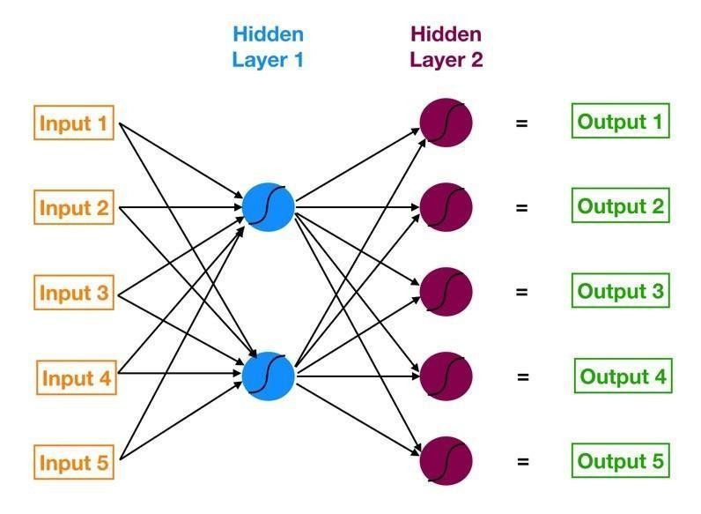
Neural Networks
Neural networks are multi-layer networks of neurons (the blue and magenta nodes in the chart below) that we use to classify things, make predictions, etc.
An artificial neuron is a mathematical function. It takes one or more inputs that are multiplied by values called “weights” and added together. This value is then passed to a nonlinear function, known as an activation function, to become the neuron’s output.

Slide 6
Convolutional Neural Networks
Similar to Neural Networks they are made up of neurons that have learnable weights and biases. Each neuron receives some inputs, performs a dot product and optionally follows it with a non-linearity.
ConvNet architectures make the explicit assumption that the inputs are images, which allows us to encode certain properties into the architecture.

Slide 7
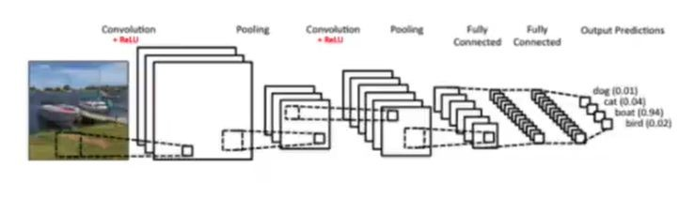
ConvNet Layers
Convolutional Layer(CONV) + ReLU
Pooling Layer(POOL)
Fully-Connected Layer(FC)

Slide 8
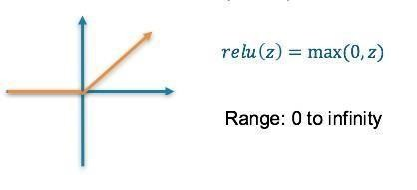
Activation Function
An activation function is a nonlinear function applied by a neuron to introduce non-linear properties in the network.
Rectified Linear Unit (ReLU) Activation Function is the most used activation function in almost all the convolutional neural networks or deep learning. The function and its derivative both are monotonic.
Softmax Function provides probability distribution for each class.

Slide 9
Packages
NumPy
Keras
Matplotlib
Sklearn
Tkinter
Tensorflow
Platforms
Google colab
Jupyter notebook
Packages and Platforms used

Slide 10







Process
Using Image Data generator we import the dataset and then by using flow-from-directory method to convert the images to Numpy array.
The dataset is already split in a 4:1 ratio and the black box of the model are finalised.
Constructed convolutional neural networks with two different Activation functions and tested for accuracy.
Adam optimization algorithm with categorical cross
entropy as a loss function and metrics as accuracy Early stopping is used to monitor on validation accuracy.
We used matplotlib.pyplot to visualize the graphs relating to accuracy and loss.
The above functionality is being integrated with UI interface to detect the disease.

Slide 11
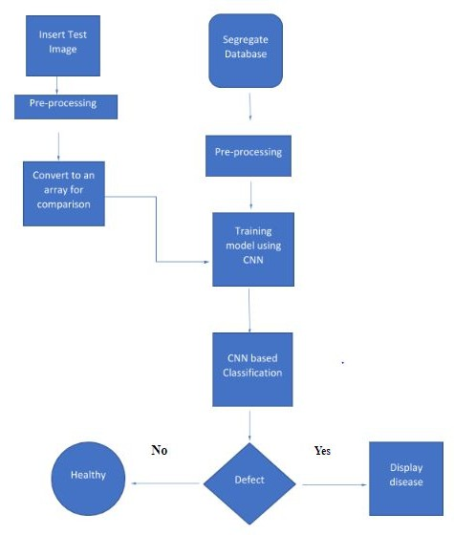
Flowchart

Slide 12
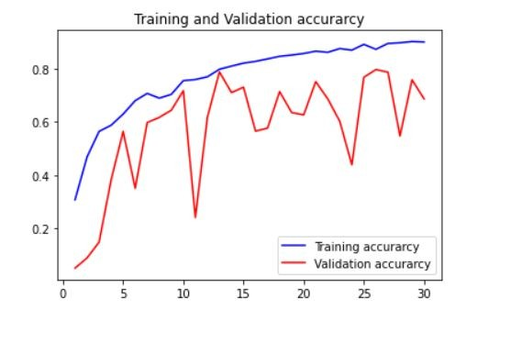
Convolutional Neural Network Model
Convolutional
Pooling
Dropout
Convolutional
Convolutional
Pooling
Dropout
Convolutional
Convolutional
Pooling
Dropout
Flatten
Dense
Dropout
Dense

Slide 13
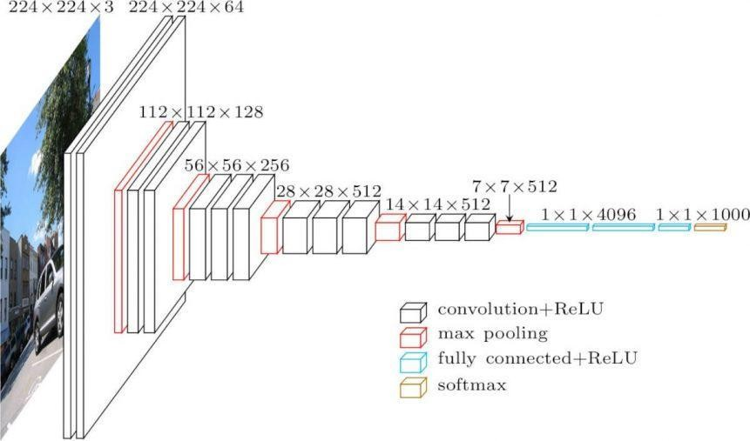
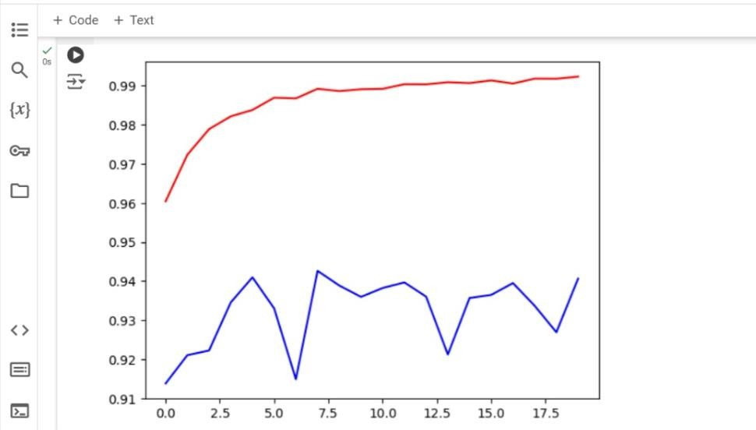
VGG16 Model

Slide 14
Conclusion
In this project specialized deep learning models were developed based on specific convolutional neural networks architectures for the detection of plant diseases through leaves images of healthy or diseased plants.
Our detector applied images captured in-place by various camera devices and also collected from various resources. Our experimental results and comparisons between various deep-learning architectures demonstrated how our deep-learning-based detector is able to successfully recognize different categories of diseases in various plants.
The final overall accuracy of the trained model was more than 90%.

Slide 15
References
S.Raj Kumar , S.Sowrirajan,” Automatic Leaf Disease Detection and Classification using Hybrid Features and Supervised Classifier”, International Journal of Advanced Research in Electrical, Electronics and Instrumentation Engineering, vol. 5, Issue 6,2016.
S. Sankaran, A. Mishra, R. Ehsani, and C. Davis, “A review of advanced techniques for detecting plant diseases,” Computers and Electronics in Agriculture, vol. 72, no. 1, pp. 1–13, 2010. View at Publisher ·View at Google Scholar · View at Scopus.
Plant Disease Detection Using Image Processing - IEEE Conference Publication
https://towardsdatascience.com/step-by-step-vgg16-implementation-in-keras-for-beginners-a833c68 6ae6c

Slide 16
Thank You

